Slide 1
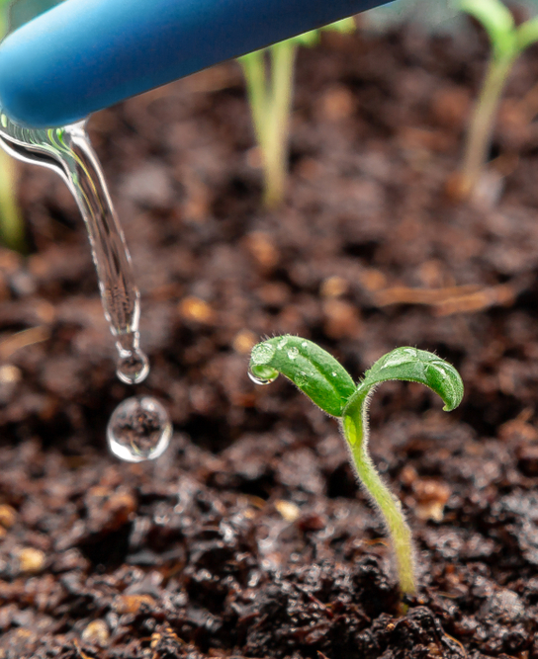
SMART IRRIGATION
Guide:
Sreerekha V K
THEERTHA T
TVE20MCA-2055

Slide 2
CONTENTS
Introduction​
Problem Statement
Motivation
Literature Review
Existing System
Proposed System
Architecture
Components
Circuit Diagram​
Implementation
Requirements
Result Analysis
Advantage
Disadvantage
Conclusion
Future scope
Publication
References

Slide 3
Introduction
Water irrigation system based on Internet of Things (IoT).
Irrigate the farmland in an efficient manner with automated irrigation System based on soil moisture.
Operates by monitoring the value on soil moisture sensor and based on the reading, motor is kept ON or OFF.
Node MCU transports the data to the digital platform of the server for processing of the data. Then those data are
sent to the mobile application of the user.
User-friendly experience with the help of mobile application.

Slide 4
PROBLEM STATEMENT and motivation
“ An automated irrigation system is needed to optimize water use for agricultural crops. The technique can be used for the application of accurate amount of water. By forming sensor network, good monitoring of water regulation in agricultural field can be achieved. “
The motivation behind the project was the drawbacks of the existing system as well as the unexplored applications of automatic irrigation system used in existing system.

Slide 5
LITERATURE REVIEW
YEAR | NAME OF THE PAPER | AUTHOR | DESCRIPTION | LIMITATIONS
2019 | Automatic Plant Watering System | M. Mayuree P. Aishwarya A. Bagubali | User will be notified to switch ON/OFF the motor | User should be alert every time to OFF the motor.
2020 | Water irrigation using IoT | J. Karpagam I. I. Merlin P. Bavithra J. Kousalya | Pump get ON and OFF automatically | no customized settings, expensive
2021 | IoT Enabled Smart Farming and Irrigation System | M. Rohith R. Sainivedhana N. Sabiyath Fatima | switch on the motor to water the plants automatically | user cannot interfere with the process

Slide 6
EXISTING SYSTEM
In existing system, we require manual supervision and labour for proper irrigation.
As per the paper "An IoT Based Smart Irrigation System," 2021 , existing system consist of a motor that pumps water automatically based on the value of sensor.
No user intervention
Expensive
No customized settings
Use of Arduino

Slide 7
PROPOSED SYSTEM
In the proposed system, parameter of soil such as moisture is sensed with the help of sensors and is displayed in the mobile application.
If the value of sensor is greater than the threshold, an alert is sent to the telegram.
Based on the alert, User can ON the motor.
Motor gets OFF automatically and manually.

Slide 8
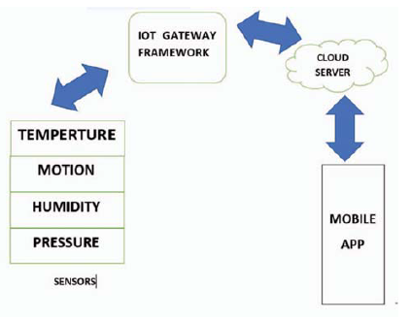
ARCHITECTURE

Slide 9
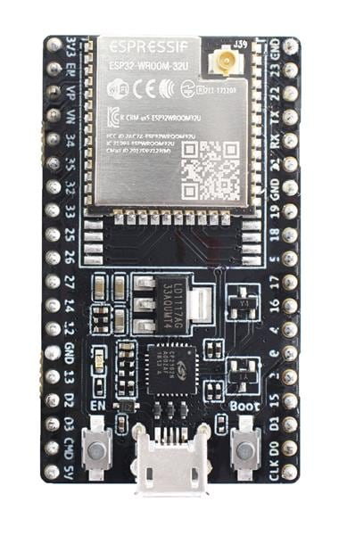
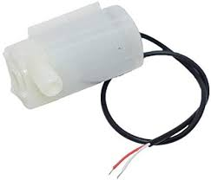
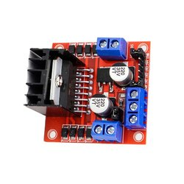
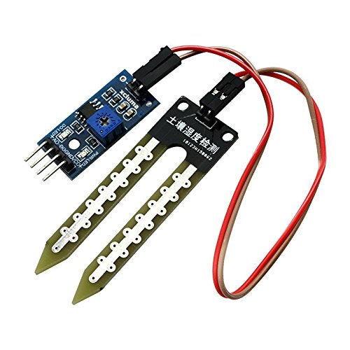
COMPONENTS
ESP32
MOTOR PUMP
Soil moisture sensor
MOTOR DRIVER

Slide 10
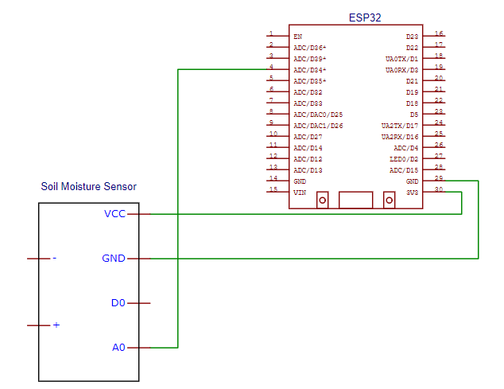
CIRCUIT DIAGRAM

Slide 11
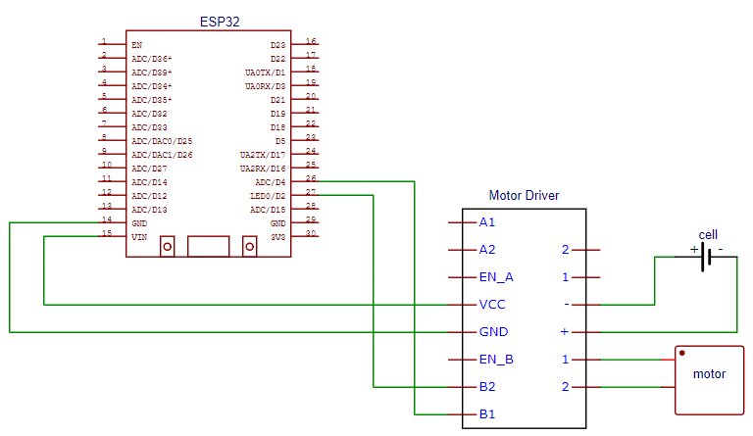

Slide 12
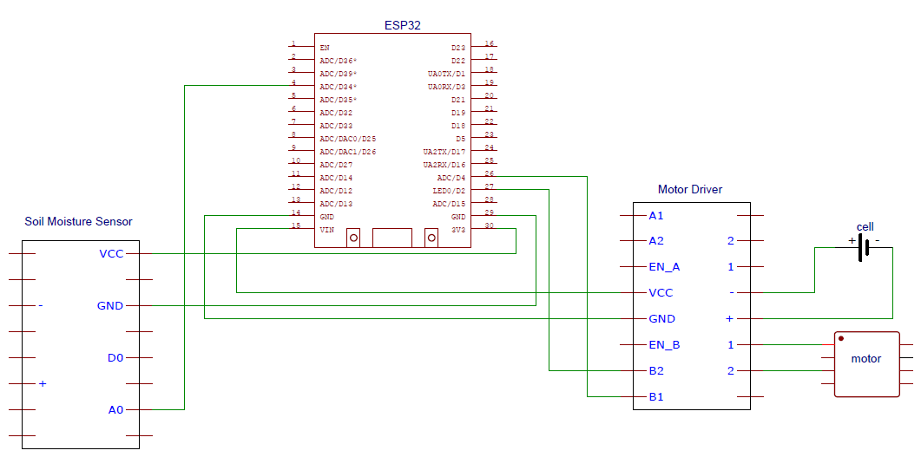

Slide 13
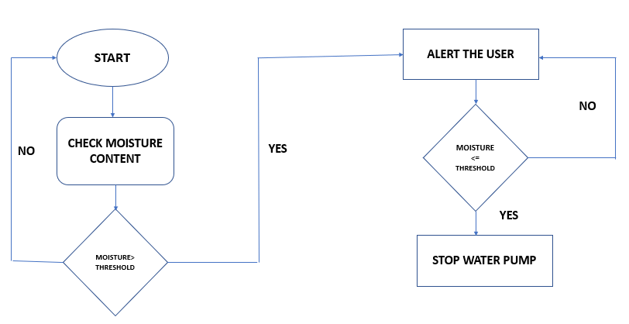
FLOW CHART

Slide 14

SCREENSHOTS

Slide 15

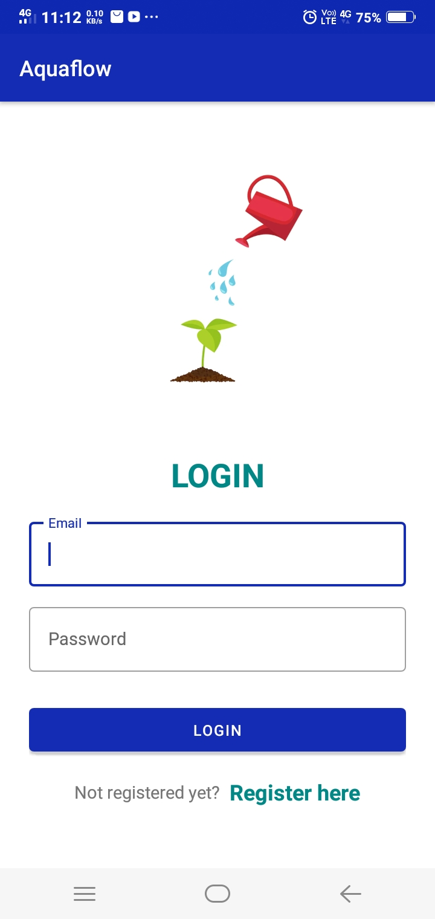


Slide 16
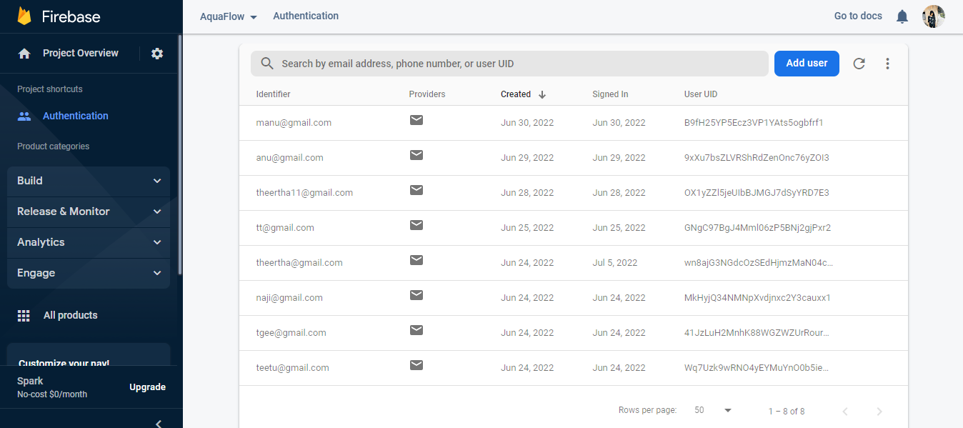

Slide 17
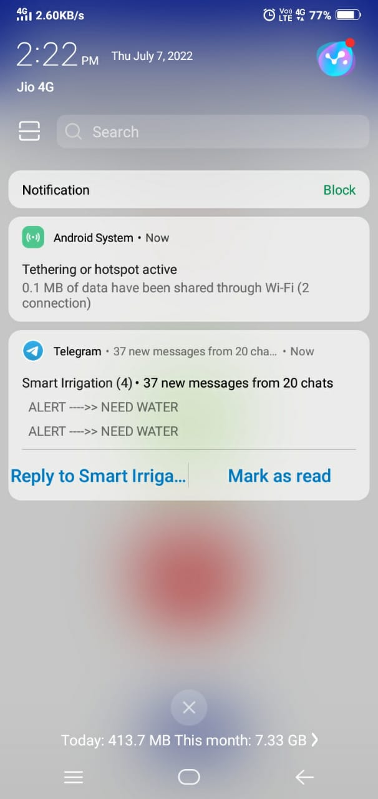
Telegram Alert Message when the soil is dry

Slide 18

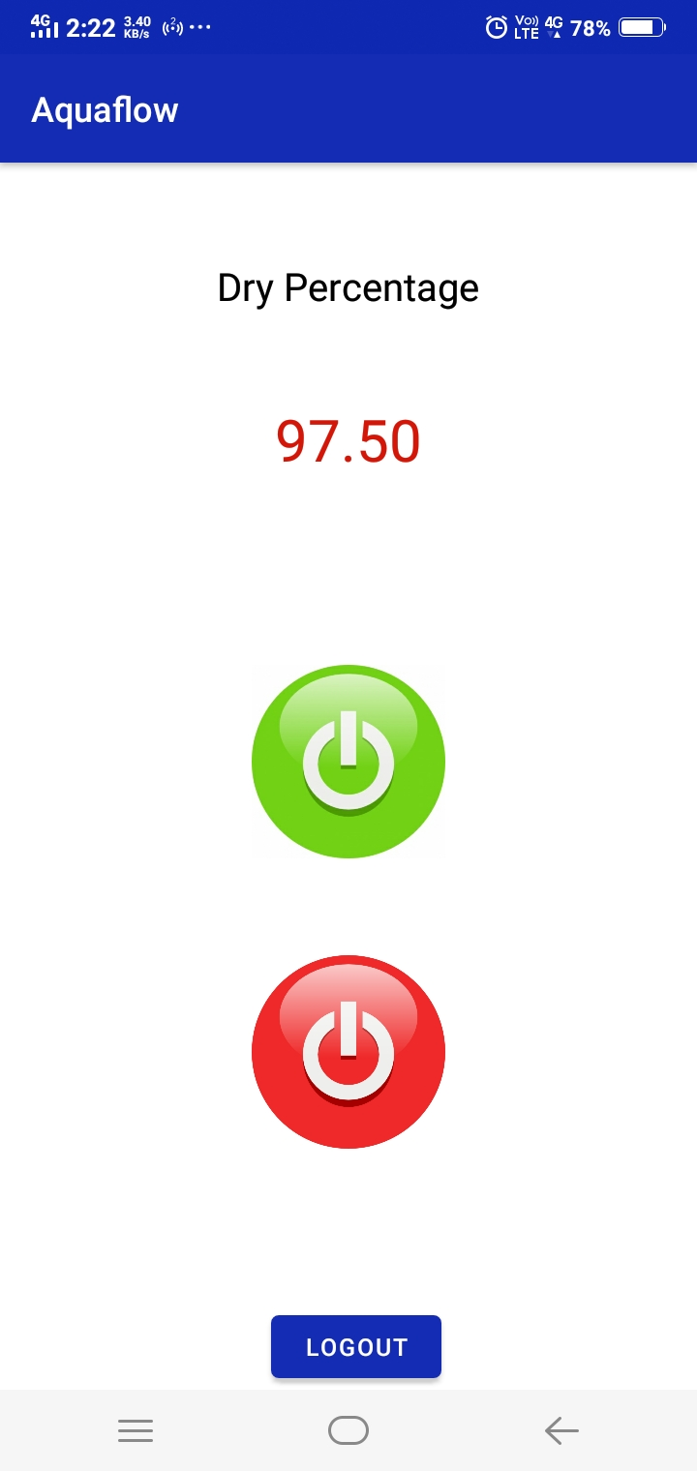
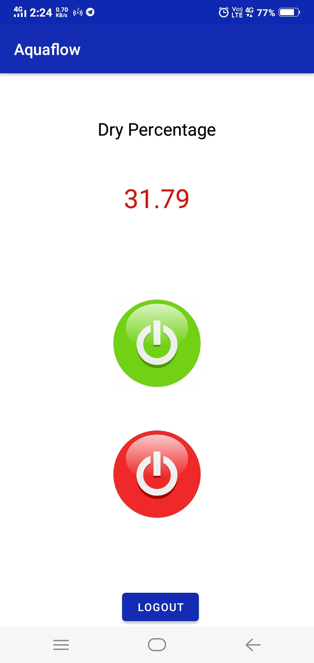

Slide 19
REQUIREMENTS
FRONT END
ANDROID
BACK END
ARDUINO

Slide 20
RESULT ANALYSIS
Telegram
Alert
Automatic motor OFF
Automatic
motor OFF
Manual
motor OFF
Automatic motor ON
Manual
motor ON
Sensing Value Display
EXISTING SYSTEM
PROPOSED SYSTEM

Slide 21
TESTING
CONDITION
MOISTURE CONTENT
WATER PUMP STATUS
TELEGRAM ALERT
TEST CASE STATUS
Dry
>3500
ON
ON
TRUE
Wet
<3500
OFF
OFF
TRUE

Slide 22
Email check | Input without ‘@’ | Invalid email | Email address is badly Formatted | TRUE
Password check | Length less than 6 | Invalid email | Password should be at least 6 characters | TRUE
TEST CASE
INPUT
EXPECTED OUTCOME
ACTUAL OUTPUT
TEST CASE STATUS

Slide 23
ADVANTAGE AND DISADVANTAGES
User friendly
Combines both automated and manual work
Cost effective
Durable
Reduce water consumption
Sensing only soil moisture
Water level do not differ with various crops

Slide 24
FUTURE SCOPE
In the future, the system will be able to categorize different crops and set the threshold according to it. So that water level for each crop can be different.
Alert failure of devices.
Now the system only senses moisture content in the soil. It can be extended as the system can sense temperature, minerals and nutrients in addition to water.
This smart irrigation can be adjusted and modified according to the changing environment.

Slide 25
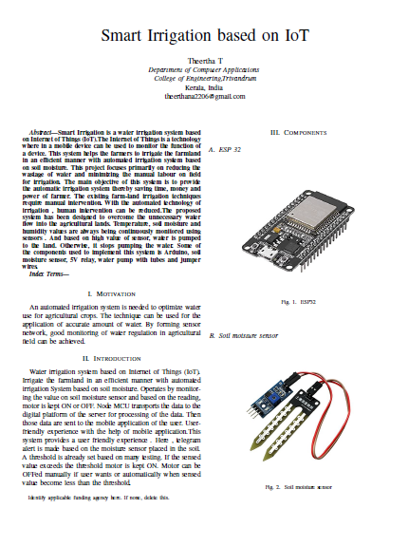
PUBLICATION

Slide 26
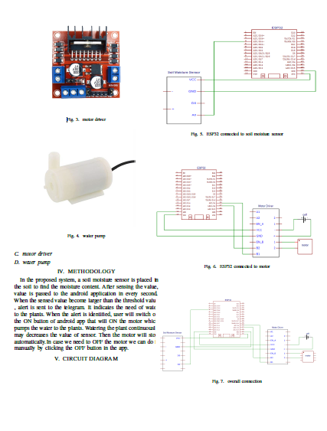

Slide 27
CONCLUSION
So far , we have discussed the working of smart irrigation.
This system provides a user friendly experience .
Here , telegram alert is made based on the moisture sensor placed in the soil.
A threshold is already set based on many testing.
If the sensed value exceeds the threshold motor is kept ON.
Motor can be OFFed manually if user wants or automatically when sensed value become less than the threshold.

Slide 28
REFERENCES
M. Rohith, R. Sainivedhana and N. Sabiyath Fatima, "IoT Enabled Smart Farming and Irrigation System," 2021
5th International Conference on Intelligent Computing and Control Systems (ICICCS), 2021, pp. 434-439, doi:
10.1109/ICICCS51141.2021.9432085.
M. Mayuree, P. Aishwarya and A. Bagubali, "Automatic Plant Watering System," 2019 International Conference
on Vision Towards Emerging Trends in Communication and Networking (ViTECoN), 2019, pp. 1-3, doi:
10.1109/ViTECoN.2019.8899452.
J. Karpagam, I. I. Merlin, P. Bavithra and J. Kousalya, "Smart Irrigation System Using IoT," 2020 6th International
Conference on Advanced Computing and Communication Systems (ICACCS), 2020, pp. 1292-1295, doi:
10.1109/ICACCS48705.2020.9074201.

